Slide 1
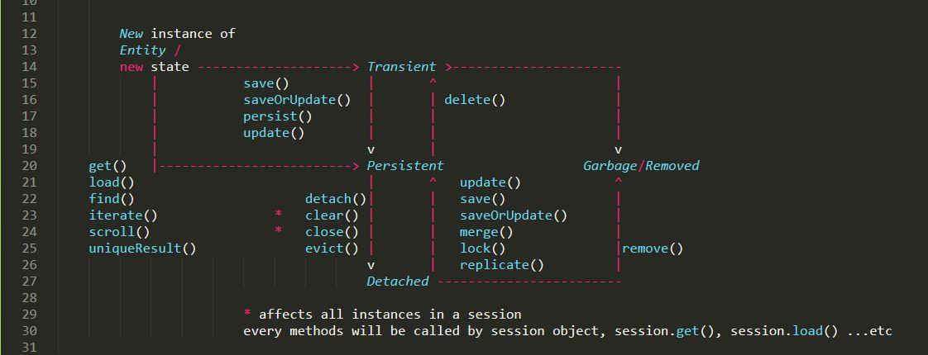
Hibernate Lifecycle :

Slide 2
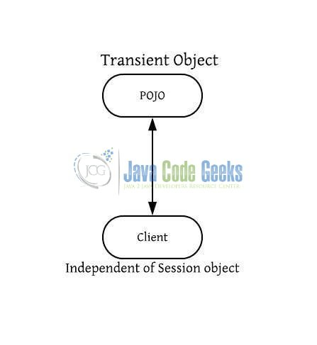
Transient :

Slide 3
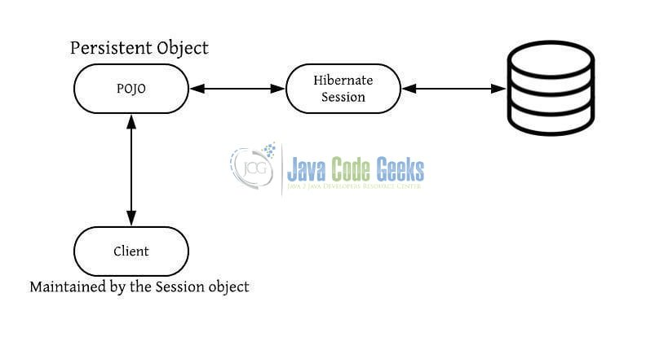
Persistent :

Slide 4
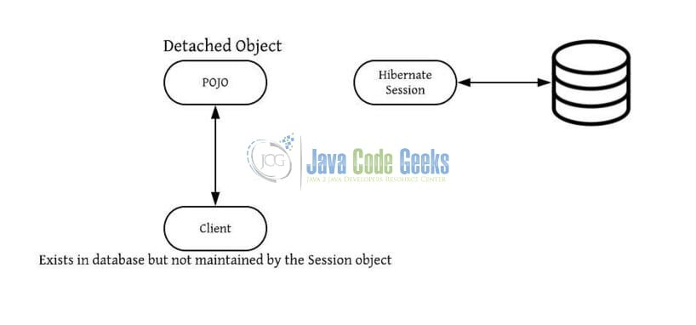
Detached :

Slide 5
Conclusion :
Newly created POJO(Plane Old Java Objects) objects will be in the Transient state.
Persistent objects represent one row of the database table and are always associated with some unique hibernate session.
Detached objects are those that have left the union with the session object.
Removed objects are those that have been passed to the session’s delete(obj) method.

Slide 6
Bonus : CommandAcceptanceException Error
<property name="hibernate.dialect" value="org.hibernate.dialect.MySQL57Dialect"/> : engine=InnoDB
<property name="hibernate.dialect">org.hibernate.dialect.MySQL5Dialect</property> : engine=MyISAM // USE THIS
<property name="hibernate.dialect">org.hibernate.dialect.MySQL8Dialect</property> : engine=InnoDB
<property name="hibernate.dialect">org.hibernate.dialect.MySQLMyISAMDialect</property> : type=MyISAM
<property name="hibernate.dialect">org.hibernate.dialect.MySQLDialect</property> : type=MyISAM

